Slide 1

Task 1
Web scraping to gain company insights
Presented by:
Pooja Bhoi
(20/April/2023)

Slide 2
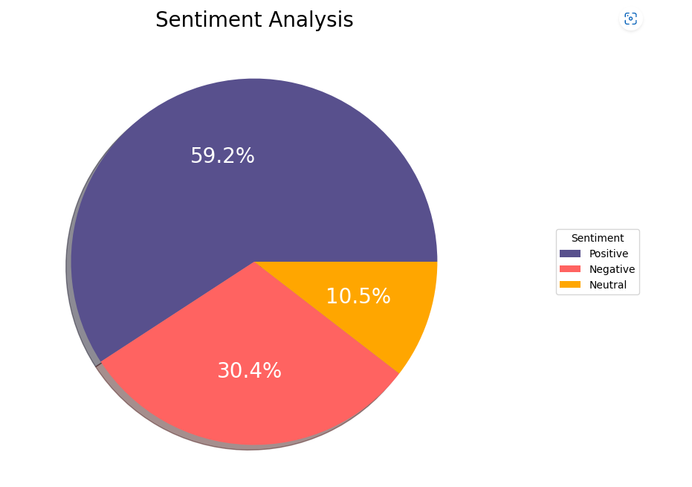
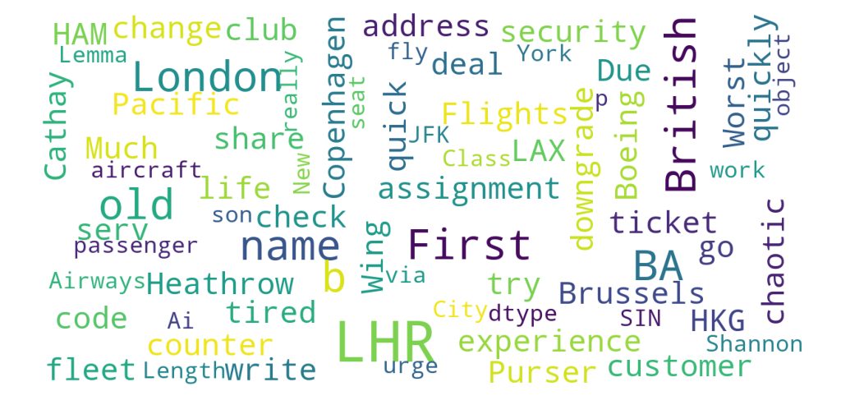
Company Insights
From cleaning 3531 reviews given by the customers,
the following was the result obtained:
Positive Reviews - 2090
Negative Reviews - 1072
Neutral Reviews – 369

